Slide 1
Grow with Oppulent grove
Eshaan Kumar
& Abhay Singh

Slide 2
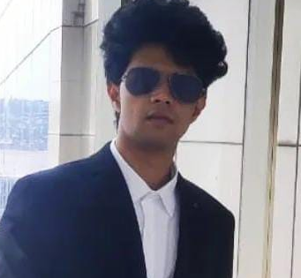
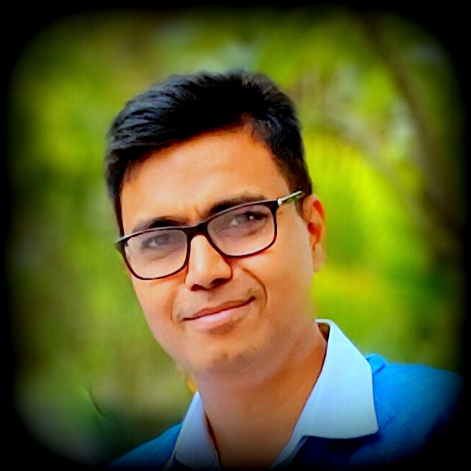
MEET OUR TEAM
Eshaan Kumar
Abhay Singh
Director-Operations
IIT Roorkee, 23 Years IT Experience
Director-Strategy
NISM Certified Research Analyst
AMFI Registered Financial Advisor
APMI Registered PMS Advisor

Slide 3
WHY OPPULENT – Our CREDENTIALS-Strategy & Operations
NISM-Series-VIII: Equity Derivatives
NISM-Series-V-A: Mutual Fund Distributors & NISM-Series-V-B: Mutual Fund Foundation
NISM-Series-XVIII: Financial Education & NISM-Series-XII: Securities Markets Foundation
NISM-Series-ll-B: Registrars to an Issue and Share Transfer Agents - Mutual Fund
NISM-Series-VII: Securities Operations and Risk Management
Authorized Financial adviser - ARN-282569 – AMFI ; EUIN-E532622
SEBI Certified Research Analyst -2410061666
Operations Team head is associated with many organizations in senior positions, Delivered multi million-dollar finance projects across multiple technologies
Developed multiple tools in Python. Extensively used Excel. Expertise in algorithm related to derivative market

Slide 4
WHY OPPULENT – Our CREDENTIALS-Strategy & Operations
NISM XXI-A PMS DISTRIBUTORS
Registered PMS advisor- APRN-00187 -APMI
SEBI Certified Research Analyst -2410061666

Slide 5

WHY OPPULENT -Credentials
Client
Duration
Monthly Gain %
Strategy
Capitals
Lakhs
Proofs
YWQ563
1 Month
20.05
Short Credit Spread- EB
7.98
VWH918
15 Days
19.92
Short Credit Spread- EB
10.00
5074
10 Days
12.8
Short Credit Spread- EB
7.45
Upstox Client
1 Month
13.93
Short Credit Spread- EB
1.70
5516
5 Month
141.00
Naked Buying Option
0.25
Sanjay-US
3 Month
13.1
BTST in small and Mid Cap
12.85
Lawyer
1 Month
80%
Hedge Option Buying
10.00
XIR508
1 Month
14.38%
Short Credit Spread- EB
10.50

Slide 6
Business Model
PROFIT SHARING
Profit earned surplus to NIFY – 50 annualized return will be shared in the ratio 60% to the Client and 40% remains with the fund management company
Management Fees
1 % of AUM will be charged as Expense Ratio annually
Minimum Investment
50 Lakhs for each account managed under PMS

Slide 7
THANK YOU
Eshaan Kumar
k23eshaan@gmail.com
Abhay Singh
abhayk007@gmail.com

